Slide 1
Maintaining Compliance in Residential Facilities
Presented by
The Bureau of Residential Facilities Licensing

Slide 2
Arizona Department of Health Services
Cara Christ M.D., Director
Division of Public Health Licensing
Colby Bower, Assistant Director
Health Care Institution Licensing
Kathryn McCanna, Branch Chief
Bureau of Residential Facilities Licensing
Harmony Duport, Bureau Chief

Slide 3
Office Locations and Phone Numbers
Phoenix: 150 N. 18th Ave., Suite 420
602-364-2639 FAX: 602-324-5872
Tucson: 400 W. Congress St., Suite 116
520-628-6965 FAX: 520-628-6991
Website: http://azdhs.gov/licensing/residential-facilities/index.php
Email: Residential.Licensing@azdhs.gov

Slide 4
Bureau of Residential Facilities Licensing (BRFL)
Licenses, regulates, and provides training to Residential Healthcare Facilities, including:
  Assisted Living Centers
  Assisted Living Homes
  Adult Foster Care Homes
  Behavioral Health Residential Facilities
  Adult Day Health Care Facilities
  Behavioral Health Respite Homes
  Adult Behavioral Health Therapeutic Homes

Slide 5
Purpose of this Training
Review various types of surveys and the survey process
Introduce the basics of preparing an acceptable Plan of Correction (POC)
Review the top ten most commonly cited deficiencies
Provide information regarding the Compliance Team and trends in Enforcement
Assist in navigating the Bureau’s website for additional resources

Slide 6
Bureau of Residential Facilities Licensing (BRFL)
Based on Arizona’s Rules and Statutes
Our goal is COMPLIANCE – we want to help you to be in compliance with the applicable Rules and Statutes for your facility
It is YOUR RESPONSIBILITY to ensure that YOU are aware of the rules as they apply to YOUR facility

Slide 7
Applicable Rules and Statutes
Licensing of Residential Facilities is governed by the Arizona Revised Statutes (“A.R.S.”), primarily:
Title 36: Public Health and Safety, Chapter 4: Health Care Institutions
Reference to a statute generally uses this format:
A.R.S. § 36.401.A.1 or A.R S. § 36.401(A)(1)
Statutes are law, and authorize the Department to adopt Regulations or Rules which govern Health Care Institutions.
Rules are contained in the Arizona Administrative Code (“A.A.C.”), primarily:
Title 9: Health Services, Chapter 10: Department of Health Services Health Care
Institution Licensing
Reference to a rule is generally in this format:
R9-10-803.A.3.a
Rules are broken down into Articles specific to each type of facility.

Slide 8
Rules Governing Residential Facilities
  Article 1: General
  Article 7: Behavioral Health Residential Facilities
  Article 8: Assisted Living Facilities
  Article 11: Adult Day Health Care Facilities
  Article 16: Behavioral Health Respite Homes
  Article 18: Adult Behavioral Health Therapeutic Homes
You can find the most up-to-date copy of the rules at our
website: http://www.azdhs.gov/licensing/residential-facilities/index.php#providers-home

Slide 9
Types of Surveys
There are five main kinds of surveys that Surveyors will conduct:
Initials
Change of Ownership (CHOWs)
Compliance
Amends
Complaints

Slide 10
Change of Ownership (CHOW) Inspections
If you are purchasing or leasing a facility that is already licensed as a Residential Facility, this is referred to as a “CHOW”
A.R.S. 36-422.D: the current licensee must notify the Department in writing at least 30 days prior to the planned change of ownership and ensure services are not interrupted
The new owner must submit an initial application and must not begin operating the facility until the Department issues a license
CMP’s will be considered and assessed if the Department does not get notification of a “CHOW”

Slide 11
Compliance Inspections
Compliance inspections are conducted once per licensure period
Your licensure period runs for 12 months
  Not always going to be January 1-December 31, it’s printed on your license
  A Surveyor can show up at ANY point within your licensure period for the compliance survey
The Surveyor will check for health and safety issues and outcomes
The Surveyor will conduct a tour of the facility, review the facility’s P&Ps, resident records, personnel records, facility records and conduct interviews
You are encouraged to participate during the inspection process, accompany the surveyor during the facility tour and ask questions
Please take notes during the survey; the Surveyor cannot give you a copy of his/her notes
Strive to be deficiency free!!

Slide 12
Amend Inspections
Anything that changes the existing license
  Bed Increase or Decrease
  Adding a service such as:
    Personal Care for BH
    Behavioral Health Services for AL
    Outdoor Behavioral Health Program for BH
    Changing the level of care
Submit a written request to make a change
Surveyor will ensure compliance before the facility is allowed to make a change and policies and procedures related to the change may be reviewed
DO NOT implement a change until approved and an amended license is issued

Slide 13
Complaint Investigation Inspections
Complaints can be received on facilities for a variety of reasons and from a variety of sources
Complaints are kept confidential; complainant information is ALWAYS kept confidential
Surveyors will gather information provided in the complaint and deficiencies may be cited, if applicable

Slide 14
The Survey Process
Most inspections are unannounced
Length of an inspection varies and may depend on:
  The size of facility
  Completeness and organization of records
  Timeliness of staff to provide records to surveyors for review
  Compliance with the rules
  Surveys follow current rules, statutes, and the facility’s Policies & Procedures (P&Ps)

Slide 15
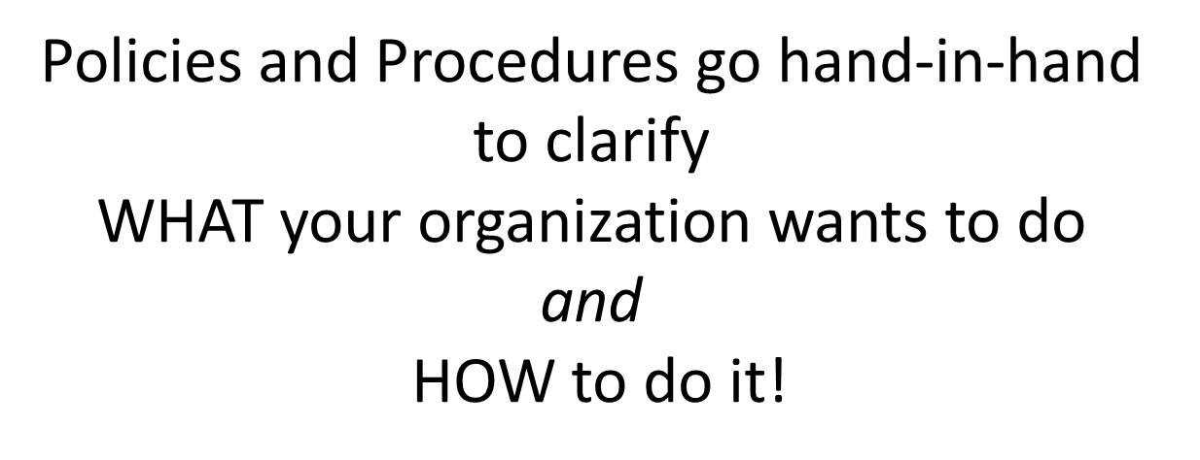
Policies & Procedures (“P&Ps”)

Slide 16
Policies & Procedures (“P&Ps”)
Policy = Clear simple statement of how your facility intends to conduct it’s services, actions or business, a set of principles to guide decisions and achieve outcomes.
Procedure = The steps to put the policy in to action, who will do what, what steps they need to take, what forms or documents to use.

Slide 17
Policies & Procedures (“P&Ps”)
R9-10-718.A.1.c/R9-10-816.A.1.c:
A manager/administrator shall ensure that policies and procedures for medication services include procedures to ensure that a resident’s medication regime and method of administration is reviewed by a medical practitioner to ensure the medication regimen meets the resident’s needs.
POLICY: Residents of ABC Care Home will have their medications reviewed every 90 days to ensure that the medication regime and method of administration meets the resident’s needs.
PROCEDURES:
1. Prior to the resident’s acceptance, the manager/administrator will contact the resident’s physician to obtain a list of the resident’s medications signed by the resident’s physician. If the resident’s physician is unable/unwilling to provide a signed list, a list of medications will be prepared by the manager/administrator, with the assistance of the resident and/or representative , and documented on the form titled “Initial Doctor’s Orders,” with the method of administration noted. The Initial Doctor’s Order form will then be faxed/hand delivered to the resident’s physician by the manager/administrator/designee for review and signature by the resident’s physician no later than the day of acceptance.
2. Every 90 days from the date of acceptance the manager/administrator will prepare a list of the resident’s medications and method of administration and document on the form titled “Subsequent Doctor’s Orders”. The Subsequent Doctor’s Order form will then be faxed/hand delivered to the resident’s physician by the manager/administrator/designee for review and signature by the resident’s physician.
3. Upon receipt of the Initial Doctor’s Order form and Subsequent Doctor’s Order form signed by the physician, the forms will be filed in the resident record under the tab labeled “Medication Orders.”
Policies don’t need to be long or complicated – a couple of sentences may be all you need for each policy area…

Slide 18
Statement of Deficiencies (SOD)
After the inspection is compete, the Surveyor will conduct an INFORMAL exit interview
  The Department will NOT give a list of deficiencies and findings may or may not mean deficiencies
  Data may be reviewed with team leader to determine if there is a deficiency
  Technical Assistance (TA) is documented and items of discussion are re-reviewed at the following inspection to ensure correction
Rosters will NOT be sent with a SOD, looking for a systemic fix & to maintain HIPAA
If no deficiencies are cited:
  A “No-Deficiency” SOD is written and mailed
If deficiencies are cited:
  A Statement of Deficiencies (SOD) is mailed to the facility
  An acceptable Plan of Correction (POC) is required to be received by the Department within 10 working days of receipt

Slide 19
Informal Dispute Resolution (IDR) Process
Referred to as an “IDR,” the IDR process is described on our website: http://azdhs.gov/als/residential/documents/informal-dispute-resolution-process.pdf
It can also be located on the Notice of Inspection Rights
The purpose of an IDR is to show the facility was in compliance at the time of inspection
It is not a guarantee a deficiency will be removed just because you disagree with a deficiency; it has to be legitimate and specific to the citation
If you wish to use the IDR process to request deficiencies be changed or removed, your IDR MUST be sent within 10 working days of receipt of the SOD to Harmony Duport, Bureau Chief
When submitting an IDR, a POC is NOT to be submitted at the same time
After the IDR is reviewed and the process is complete, the POC will be due

Slide 20
Plan of Correction (POC)
Required from the facility within 10 days after a facility received a SOD with deficiencies
Read the cover letter that comes with the SOD carefully. It gives you information and deadlines that apply to your situation
You will need to write a POC for each citation on the space provided on your SOD, or attach the POC on a separate paper
Please follow the steps stated on the cover letter to complete the POC process. Call your surveyor if you have questions
You can find a copy of the SOD cover letter with a sample POC on our website: http://azdhs.gov/licensing/residential-facilities/index.php

Slide 21
Plan of Correction (POC)
The POC MUST outline the specific steps taken to correct each deficiency noted, and MUST include the following:
How the deficiency is to be corrected, on both a temporary and permanent basis
The date the correction will be/was completed
The name, title, and/or position of the person responsible for implementing the corrective action
A description of the monitoring system you will use to prevent the deficiency from recurring
The signature, title, and date signed of the person responsible for the POC on the first page of the SOD

Slide 22
Monitoring Systems for Prevention
NOT Acceptable = The manager/administrator ensures that all residents will have proof of freedom from pulmonary tuberculosis (TB).
NOT Acceptable = The manager/administrator ensures that it will not happen again.
Acceptable = The manager/administrator will conduct a monthly review of resident records to ensure that all residents have current proof of freedom from pulmonary tuberculosis (TB).
Acceptable = The manager will maintain a list of due dates for resident TB tests and will check the list monthly to see if any residents are due for a TB test during the month to ensure that all residents have current proof of freedom from pulmonary tuberculosis.

Slide 23
Plan of Correction (POC)
Return the signed SOD with the POC to the Department ON TIME and include any supporting documentation (such as pictures, etc.) as proof that the necessary corrections have been made
Keep a copy for your records - You must make the SOD and POC available to the public
Late POC’s
  Get them in on time!
  Late letters will be sent and could lead to further enforcement action, which can lead to civil money penalties
  There are NO POC extensions granted
Once received, your surveyor will review your POC

Slide 24
Plan of Correction (POC)
Acceptable POC’s
  Surveyor will recommend closing the survey
Unacceptable POC’s
  You will receive a letter detailing what is missing
  Read the letter; if it was unacceptable, it means the POC did not meet one or more of the requirements in the SOD letter
  A POC which includes language that argues the deficiency, or does not address a deficiency, will be returned as unacceptable
  Call your surveyor if you have additional questions
Depending on the circumstances, the Surveyor may do an onsite follow-up inspection to ensure all deficiencies are corrected before closing the inspection
Reminder: Your survey results and POC are public record

Slide 25
Top Ten Deficiencies - 2018
(Assisted Living)
R9-10-816.B.3.b: Medication Services
R9-10-807.B.1.a-b: Residency and Residency Agreements
R9-10-819.A.11: Environmental Standards
R9-10-816.F.1: Medication Services
R9-10-818.A.4: Emergency and Safety Standards
R9-10-816.B.3.c: Medication Services
R9-10-811.C.17: Medical Records
R9-10-818.A.2: Emergency and Safety Standards
R9-10-806.A.7.a-b: Personnel
R9-10-807.A.1-2: Residency and Residency Agreements

Slide 26
Top Deficiencies (Assisted Living) #1
R9-10-816.B.3.b: Medication Services
B. If an assisted living facility provides medication administration, a manager shall ensure that:
3. A medication administered to a resident:
b. Is administered in compliance with a medication order.

Slide 27
Top Deficiencies (Assisted Living) #2
R9-10-807.B.1.a-b: Residency and Residency Agreements
B. A manager shall ensure that before or at the time of acceptance of an individual, the individual submits documentation that is dated within 90 calendar days before the individual is accepted by an assisted living facility and:
1. If an individual is requesting or is expected to receive supervisory care services, personal care services, or directed care services:
a. Includes whether the individual requires:
i. Continuous medical services,
ii. Continuous or intermittent nursing services, or
iii. Restraints; and
b. Is dated and signed by a:
i. Physician,
ii. Registered nurse practitioner,
iii. Registered nurse, or
iv. Physician assistant.

Slide 28
Top Deficiencies (Assisted Living) #3
R9-10-819.A.11: Environmental Standards
A. A manager shall ensure that:
11. Poisonous or toxic materials stored by the assisted living facility are maintained in labeled containers in a locked area separate from food preparation and storage, dining areas, and medications and are inaccessible to residents.

Slide 29
Top Deficiencies (Assisted Living) #4
R9-10-816.F.1: Medication Services
F. When medication is stored by an assisted living facility, a manager shall ensure that:
1. Medication is stored in a separate locked room, closet, cabinet, or self-contained unit and used only for medication storage.

Slide 30
Top Deficiencies (Assisted Living) #5
R9-10-818.A.4: Emergency and Safety Standards
A. A manager shall ensure that:
4. A disaster drill for employees is conducted on each shift at least once every three months and documented.

Slide 31
Top Deficiencies (Assisted Living) #6
R9-10-816.B.3.c: Medication Services
B. If an assisted living facility provides medication administration, a manager shall ensure that:
3. A medication administered to a resident:
c. Is documented in the resident’s medical record.

Slide 32
Top Deficiencies (Assisted Living) #7
R9-10-811.C.17: Medical Records
C. A manager shall ensure that a resident’s medical record contains:
17. Documentation of notification of the resident of the availability of vaccination for influenza and pneumonia, according to A.R.S. 36-406(1)(d).

Slide 33
Top Deficiencies (Assisted Living) #8
R9-10-818.A.2: Emergency and Safety Standards
A. A manager shall ensure that:
2. The disaster plan required in subsection (A)(1) is reviewed at least once every 12 months.

Slide 34
Top Deficiencies (Assisted Living) #9
R9-10-806.A.7.a-b: Personnel
A. A manager shall ensure that:
7. A manager, a caregiver, and an assistant caregiver, or an employee or a volunteer who has or is expected to have more than eight hours per week of direct interaction with residents, provides evidence of freedom from infectious tuberculosis:
a. On or before the date the individual begins providing services at or on behalf of the assisted living facility, and
b. As specified in R9-10-113.

Slide 35
Top Deficiencies (Assisted Living) #10
R9-10-807.A.1-2: Residency and Residency Agreements
A. Except as provided in R9-10-808(B)(2), a manager shall ensure that a resident provides evidence of freedom from infectious tuberculosis:
1. Before or within seven calendar days after the resident’s date of occupancy, and
2. As specified in R9-10-113.

Slide 36
Top Ten Deficiencies - 2018
(Behavioral Health)
R9-10-720.B.4: Emergency and Safety Standards
R9-10-706.F.1-2: Personnel
R9-10-721.A.14: Environmental Standards
R9-10-718.C.6.a: Medication Services
R9-10-707.A.12.a-b: Admission; Assessment
R9-10-720.B.5: Emergency and Safety Standards
R9-10-707.A.5: Admission; Assessment
R9-10-722.B.5.a: Physical Plant Standards
R9-10-707.A.7.a: Admission; Assessment
R9-10-721.A.10: Environmental Standards

Slide 37
Top Deficiencies (Behavioral Health) #1
R9-10-720.B.4: Emergency and Safety Standards
B. Except for an outdoor behavioral health care program provided by a behavioral health residential facility, an administrator shall ensure that:
4. A disaster drill for employees is conducted on each shift at least once every three months and documented.

Slide 38
Top Deficiencies (Behavioral Health) #2
R9-10-706.F.1-2: Personnel
F. An administrator shall ensure that a personnel member, or an employee, a volunteer, or a student who has or is expected to have more than eight hours of direct interaction per week with residents, provides evidence of freedom from infectious tuberculosis:
1. On or before the date the individual begins providing services at or on behalf of the behavioral health residential facility, and
2. As specified in R9-10-113.

Slide 39
Top Deficiencies (Behavioral Health) #3
R9-10-721.A.14: Environmental Standards
A. Except for an outdoor behavioral health care program provided by a behavioral health residential facility, an administrator shall ensure that:
14. Poisonous or toxic materials stored by the behavioral health residential facility are maintained in labeled containers in a locked area separate from food preparation and storage, dining areas, and medications and are inaccessible to residents.

Slide 40
Top Deficiencies (Behavioral Health) #4
R9-10-718.C.6.a: Medication Services
C. If behavioral health residential facility provides assistance in the self-administration of medication, an administrator shall ensure that:
6. Assistance in the self-administration of medication provided to a resident:
a. Is in compliance with an order.

Slide 41
Top Deficiencies (Behavioral Health) #5
R9-10-707.A.12.a-b: Admission; Assessment
A. An administrator shall ensure that:
12. Except as provided in subsection (E)(1)(d), a resident provides evidence of freedom from infectious tuberculosis:
a. Before or within seven calendar days after the resident’s admission, and
b. As specified in R9-10-113.

Slide 42
Top Deficiencies (Behavioral Health) #6
R9-10-720.B.5: Emergency and Safety Standards
B. Except for an outdoor behavioral health care program provided by a behavioral health residential facility, an administrator shall ensure that:
5. An evacuation drill for employees and residents on the premises is conducted at least once every six months on each shift.

Slide 43
Top Deficiencies (Behavioral Health) #7
R9-10-707.A.5: Admission; Assessment
A. An administrator shall ensure that:
5. Except as provided in subsection (E)(1)(a), a medical practitioner performs a medical history and physical examination or a registered nurse performs a nursing assessment on a resident within 30 calendar days before admission or within seven calendar days after admission and documents the medical history and physical examination or nursing assessment in the resident’s medical record within seven calendar days after admission.

Slide 44
Top Deficiencies (Behavioral Health) #8
R9-10-722.B.5.a: Physical Plant Standards
B. An administrator shall ensure that:
5. A resident bathroom provides privacy when in use and contains:
a. A shatter-proof mirror, unless the resident’s treatment plan allows for otherwise.

Slide 45
Top Deficiencies (Behavioral Health) #9
R9-10-707.A.7.a: Admission; Assessment
A. An administrator shall ensure that:
7. If a behavioral health assessment is conducted by a:
a. Behavioral health technician or registered nurse, within 24 hours a behavioral health professional, certified or licensed to provide the behavioral health services needed by the resident, reviews and signs the behavioral health assessment to ensure that the behavioral health assessment identifies the behavioral health services needed by the resident.

Slide 46
Top Deficiencies (Behavioral Health) #10
R9-10-721.A.10: Environmental Standards
A. Except for an outdoor behavioral health care program provided by a behavioral health residential facility, an administrator shall ensure that:
10. Hot water temperatures are maintained between 95 degrees and 120 degrees F in the areas of the behavioral health residential facility used by residents.

Slide 47
Levels of Medication Assistance
SELF-ADMINISTRATION OF MEDICATION
“A patient having access to and control of the patient’s medication and may include the patient receiving limited support while taking the medication”
The resident stores medications in a locked area in their room or residential unit
The resident takes medications independently
Rules require the facility to have policy and procedures for monitoring
a resident who self-administers medication.

Slide 48
Levels of Medication Assistance
ASSISTANCE IN THE SELF-ADMINISTRATION OF MEDICATION
“Restricting a patient’s access to the patient’s medication and providing support to the patient while the patient takes the medication to ensure that the medication is taken as ordered”
The facility is required to store the resident’s medications in a separate locked room, closet, cabinet, or self-contained unit used only for medication storage

Slide 49
Levels of Medication Assistance
ASSISTANCE IN THE SELF-ADMINISTRATION OF MEDICATION
The following assistance is provided to a resident
-A reminder when it is time to take the medication;
-Opening the medication container or medication organizer for the resident;
-Observing the resident while the resident removes the medication from the container or medication organizer;
-Verifying that the medication is taken as ordered by the resident’s medical practitioner and according to the schedule specified on the medical practitioner’s order; or
-Observing the resident while the resident takes the medication

Slide 50
Levels of Medication Assistance
MEDICATION ADMINISTRATION
“Restricting a patient’s access to the patient’s medication and providing the medication to the patient or applying the medication to the patient’s body, as ordered by a medical practitioner”
The facility is required to store the resident’s medications in a separate locked room, closet, cabinet, or self-contained unit used only for medication storage

Slide 51
Quality Management
“Ongoing activities designed and implemented by a health care institution to improve the delivery of medical services, nursing services, health-related services, and ancillary services provided by the health care institution”

Slide 52
Quality Management
R9-10-704/R9-10-804 requires facilities to establish, document and implement a plan for an ongoing quality management program that includes:
A method to identify, document and evaluate incidents;
A method to collect data to evaluate services provided to residents;
A method to evaluate the data collected to identify a concern about the delivery of services related to resident care;
A method to make changes or take action as a result of the identification of a concern about the delivery of services related to resident care; and
The frequency of submitting a documented report that includes an identification of each concern about the delivery of services related to resident care and any changes made or action taken as a result of the identification of a concern about the delivery of services related to resident care to the governing authority

Slide 53

Compliance Team
Management team who reviews deficient practices and repeat deficiencies in facilities
Depending on scope and severity, outcomes and health and safety risks, enforcement actions are typically progressive in nature
Penalties are assessed, up to and including revocation
-Facilities have had their licenses revoked

Slide 54
Enforcement Actions
Not a comprehensive list, but common items referred for Enforcement include:
  Late renewal applications
  Repeat/uncorrected deficiencies
  Fingerprinting issues
  Personnel issues
  Residents left alone
  False documentation

Slide 55
Late Renewal Applications
You are responsible for ensuring that your renewal application is submitted on time
(Reminder cards are no longer being mailed, but e-mail reminders will be issued as long as your e-mail address is current on the renewal portal.)
All renewals must be done online. Once you register for an account, you can renew your license online! https://licensing.azdhs.gov/LicensingOnline/RES
When a completed renewal application and all fees are received, the Department will mail you your new license. Hang the original license on the wall at the time of the effective date.

Slide 56
Late Renewal Applications
Renewal applications are due to the Bureau no later than 60 days prior to the expiration date on the license
An application received 59 or fewer days prior to the license expiration date will result in the assessment of a civil penalty of $250.00 for a first offense. Subsequent offenses will result in higher penalties.
If an application is not received prior to the expiration date of the license, the facility may be considered closed
If such a facility is still providing services, enforcement action may be taken, as the facility is providing unlicensed care

Slide 57
Repeat/Uncorrected Deficiencies
After a survey when deficiencies are cited, a Plan of Correction (POC) is required
Once the POC is received, reviewed, and accepted, the deficiency should NOT be found at or during the next inspection
If it is, it is a repeat or uncorrected deficiency
Most often, a repeat deficiency has a starting fine of $250.00

Slide 58
Fingerprinting Issues
Fingerprint Statute - A.R.S.§ 36-411
Direct care staff in all facilities shall have valid fingerprint clearance cards that are issued pursuant to title 41, chapter 12, article 3.1 or shall apply for a fingerprint clearance card within twenty working days of employment or beginning volunteer work.
AND
Owners shall make documented, good faith efforts to:
-Contact previous employers to obtain information or recommendations that may be relevant to a person's fitness to work in a residential care institution, nursing care institution or home health agency.
-Verify the current status of a person's fingerprint clearance card.

Slide 59
Fingerprinting Issues
Fingerprint Statute - A.R.S.§ 36-425.03 (Specific to Behavioral Health Residential Facilities
providing services to children)
Children’s behavioral health program personnel, including volunteers, shall have a valid fingerprint clearance card issued pursuant to title 41, chapter 12, article 3.1 or, within seven working days after employment or beginning volunteer work, shall apply for a fingerprint clearance card.
AND
Children's behavioral health program personnel shall certify on forms that are provided by the department and notarized that they are not awaiting trial on or have never been convicted of or admitted in open court or pursuant to a plea agreement to committing any of the offenses listed in section 41-1758.03, subsection B or C in this state or similar offenses in another state or jurisdiction.
AND
Employers of children's behavioral health program personnel shall make documented, good faith efforts to contact previous employers of children's behavioral health program personnel to obtain information or recommendations that may be relevant to an individual's fitness for employment in a children's behavioral health program.

Slide 60
Personnel Issues
For Assisted Living facilities and BH residential authorized to provide Personal Care services:
  Leaving a resident with a volunteer, staff, or individual who does not have Caregiver training approved through the NCIA Board
Caregivers do not have current CPR/First Aid training, or training not complete per P&P and/or regulations which requires CPR training to include a demonstration of the caregiver’s ability to provide CPR (Online courses not acceptable)

Slide 61
Residents Left Alone
All subclasses require AT LEAST one personnel member present at the facility when there is a resident on the premises
  Many facilities require awake staff 24 hours a day, while some do not, so check your P&Ps and the regulations!
Going around the corner to a house or facility “next door” does NOT count as being on premises

Slide 62
False Documentation
Documentation may be provided to you from a new employee that has been falsified. You are still responsible to verify the employee is qualified for the position hired
Common falsified documents include:
  FP cards
  Caregiver certificates

Slide 63
False Documentation – FP Cards
To verify the current status of an individual’s fingerprint clearance card:
-Check online at: https://webapps.azdps.gov/public_inq_acct/acct/ShowClearanceCardStatus.action and print the document showing verification
OR
-Verify by phone by calling DPS at:
602-223-2279 and document the date you called, person you spoke to and badge number and the status of the fingerprint card

Slide 64
False Documentation – CG Certificates
Caregiver training is regulated by the Arizona Board of Nursing Care Institution Administrators and Assisted Living Facility Managers Board (NCIA Board)
Caregiver training certificates DO NOT expire
For caregiver certificates issued prior to August 3, 2013, the Department and NCIA Board may assist with certificate verification
A current list of approved caregiver training programs can be found at: www.aznciaboard.us
Any training taken after August 3, 2013, from a provider not on the NCIA approved list is NOT valid
Verification of a person who took training after August 3, 2013 can be checked at the following website: https://az.tmuniverse.com/

Slide 65
False Documentation – CG Certificates
The older acceptable certificates have:
  An ALTP # and name of the training program
  Name of the caregiver
  Date of completion
  Evidence of three levels of care: supervisory, personal and directed
  Evidence of at least 62 hours of training
  Signed by the trainer
The newer certificates have:
  The same format and a total of 104 hours, some of which may be distance learning
  A validation code at the bottom which is different for each person…If duplicated = fraudulent

Slide 66
Online Resources
Bureau of Residential Facilities Website:
http://azdhs.gov/licensing/residential-facilities/index.php
Frequently Asked Questions
License Application Forms
How to Prepare a Plan of Correction (POC)
Informal Dispute Resolution
Links to rules, statutes, enforcement actions
www.azcarecheck.com: facility information, including survey history and enforcement actions

Slide 67

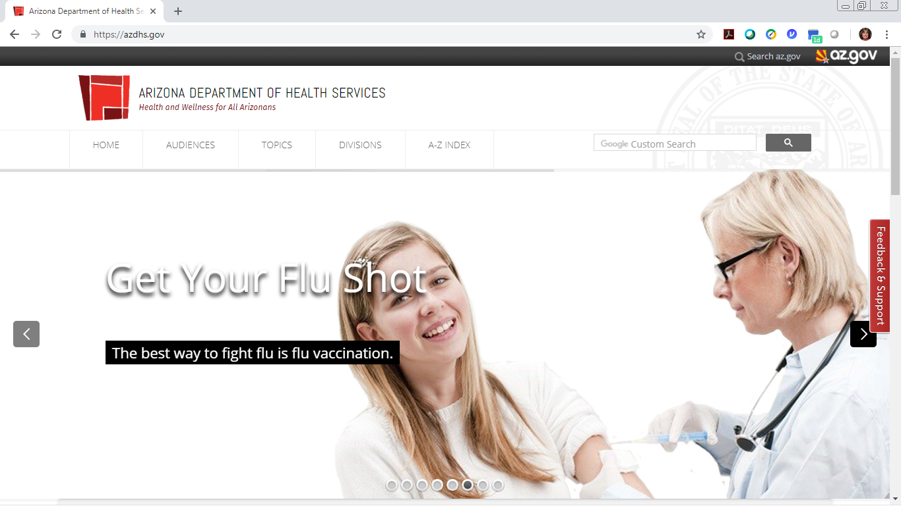

Slide 68
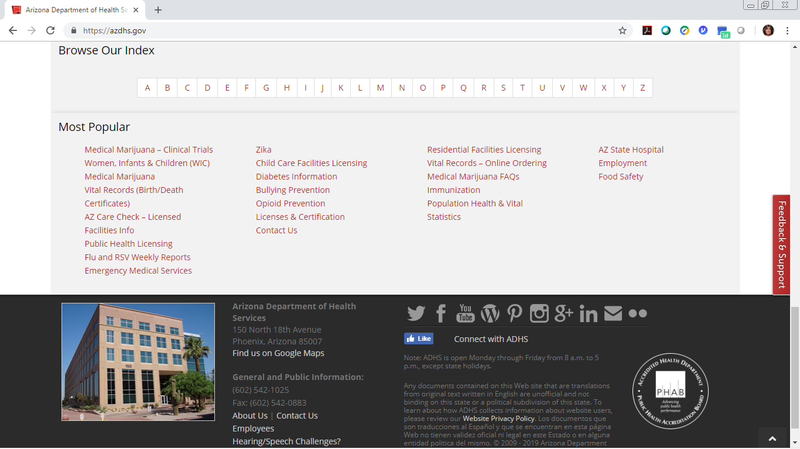


Slide 69
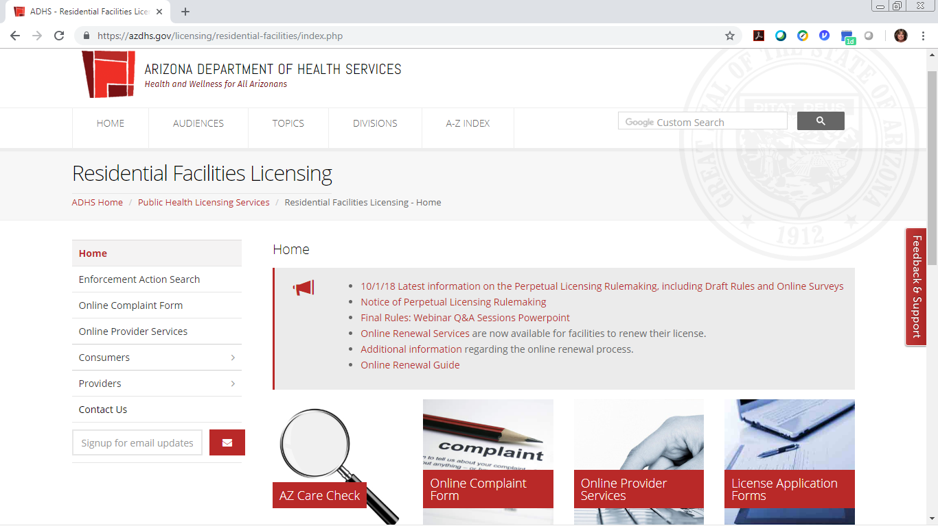



Slide 70
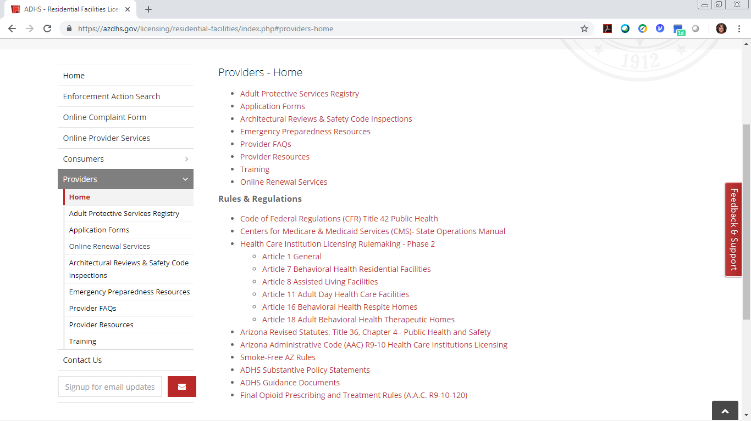



Slide 71
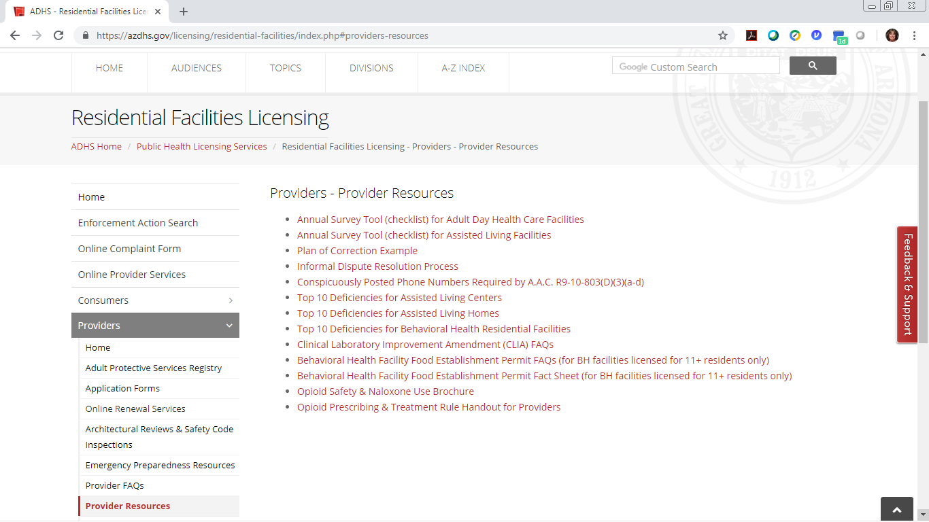


Slide 72
QUESTIONS?
Phoenix office: 150 N. 18th Ave., Suite 420
602-364-2639 FAX: 602-324-5872
Tucson office: 400 W. Congress St., Suite 116
520-628-6965 FAX: 520-628-6991
Website: http://azdhs.gov/licensing/residential-facilities/index.php
Email: Residential.Licensing@azdhs.gov

Slide 73
THANK YOU
Nicole Morong| Team Leader
Lynn O’Malia | Surveyor
Deanna Adams | Surveyor
Residential.licensing@azdhs.gov | 602-364-2639
www.azdhs.gov

